Slide 1
Building a Telegram Bot for Text Extraction from Images using AWS Services
M. Pranav
2100030310
CSC

Slide 2
Services used
1. S3 Bucket
2. Lambda
3. Dynamo DB
4. API Gateway
5. IAM Role

Slide 3
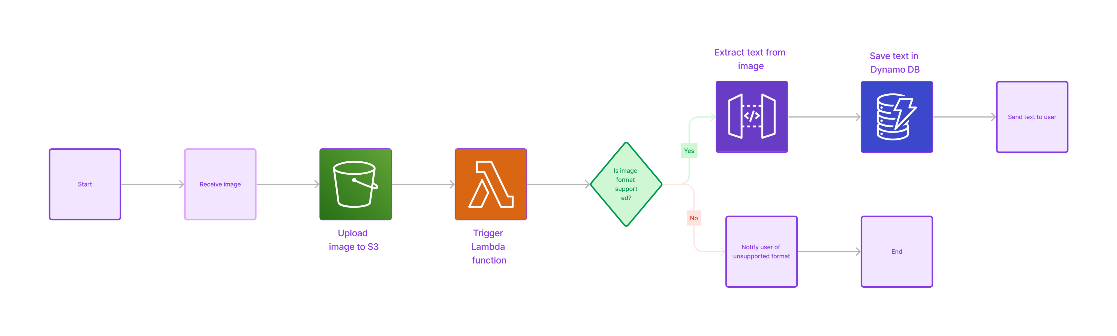
Outline of the project-

Slide 4
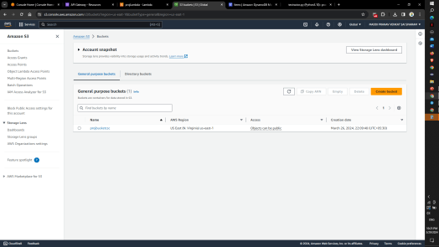
S3 Bucket-
An Amazon S3 bucket, provided by Amazon Web Services (AWS), serves as a cloud storage container. It is designed to store various data types, including files and other forms of data. S3 buckets are known for their scalability, security, and durability, making them suitable for storing diverse data types such as images, videos, backups, and log files.

Slide 5
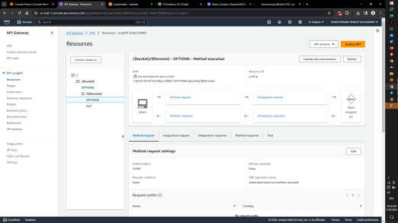
API Gateway-
API Gateway is an AWS-managed service that simplifies the process for developers to create, publish, manage, monitor, and secure APIs, regardless of scale. It serves as a primary access point for applications to interact with backend services like Lambda functions, DynamoDB tables, or EC2 instances, enabling access to data, business logic, or functionality.

Slide 6
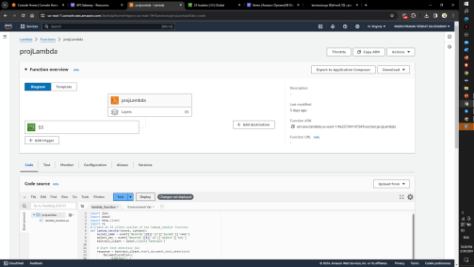
LAMBDA-
AWS Lambda is a serverless computing service that enables you to execute code without the need to provision or oversee servers. By uploading your code, which can be written in languages like Node.js, Python, Java, or C#, Lambda processes your code based on events such as modifications to data in an S3 bucket, updates to a DynamoDB table, or HTTP requests managed via API Gateway.

Slide 7
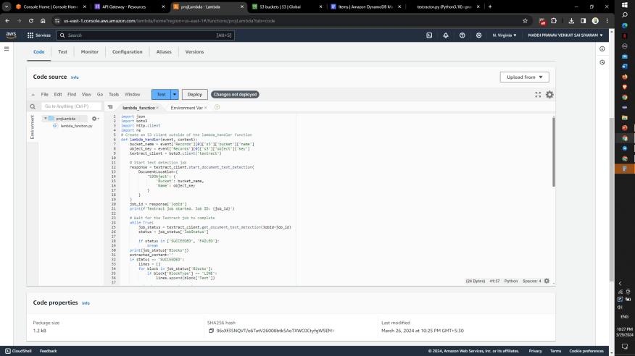
CODE-

Slide 8
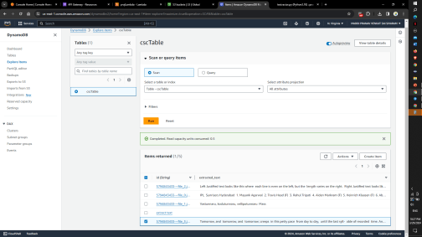
Dynamo DB-
Amazon DynamoDB is a fully managed NoSQL database service provided by AWS. It offers fast and predictable performance with seamless scalability. DynamoDB is designed to handle large amounts of data and can serve applications that require single-digit millisecond latency.

Slide 9
The Output-

Slide 10
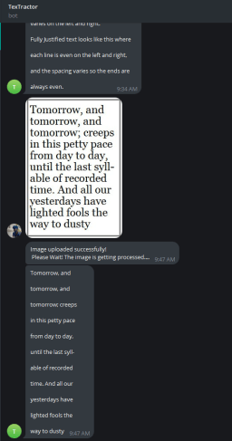

Slide 11
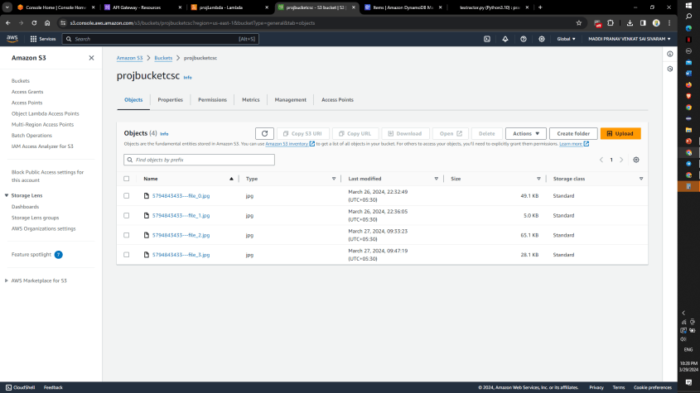
Images are stored in s3

Slide 12
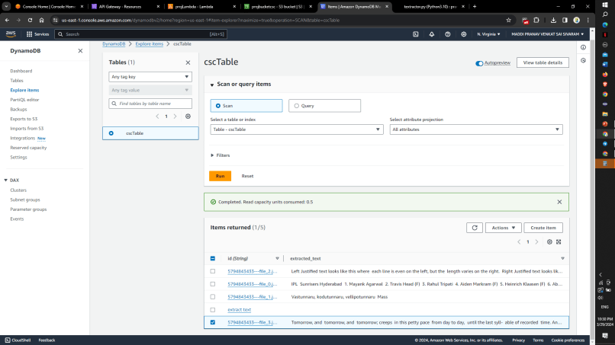
Text is stored in DynamoDB

Slide 13
Thank you

